Slide 1
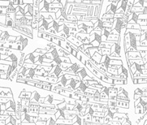
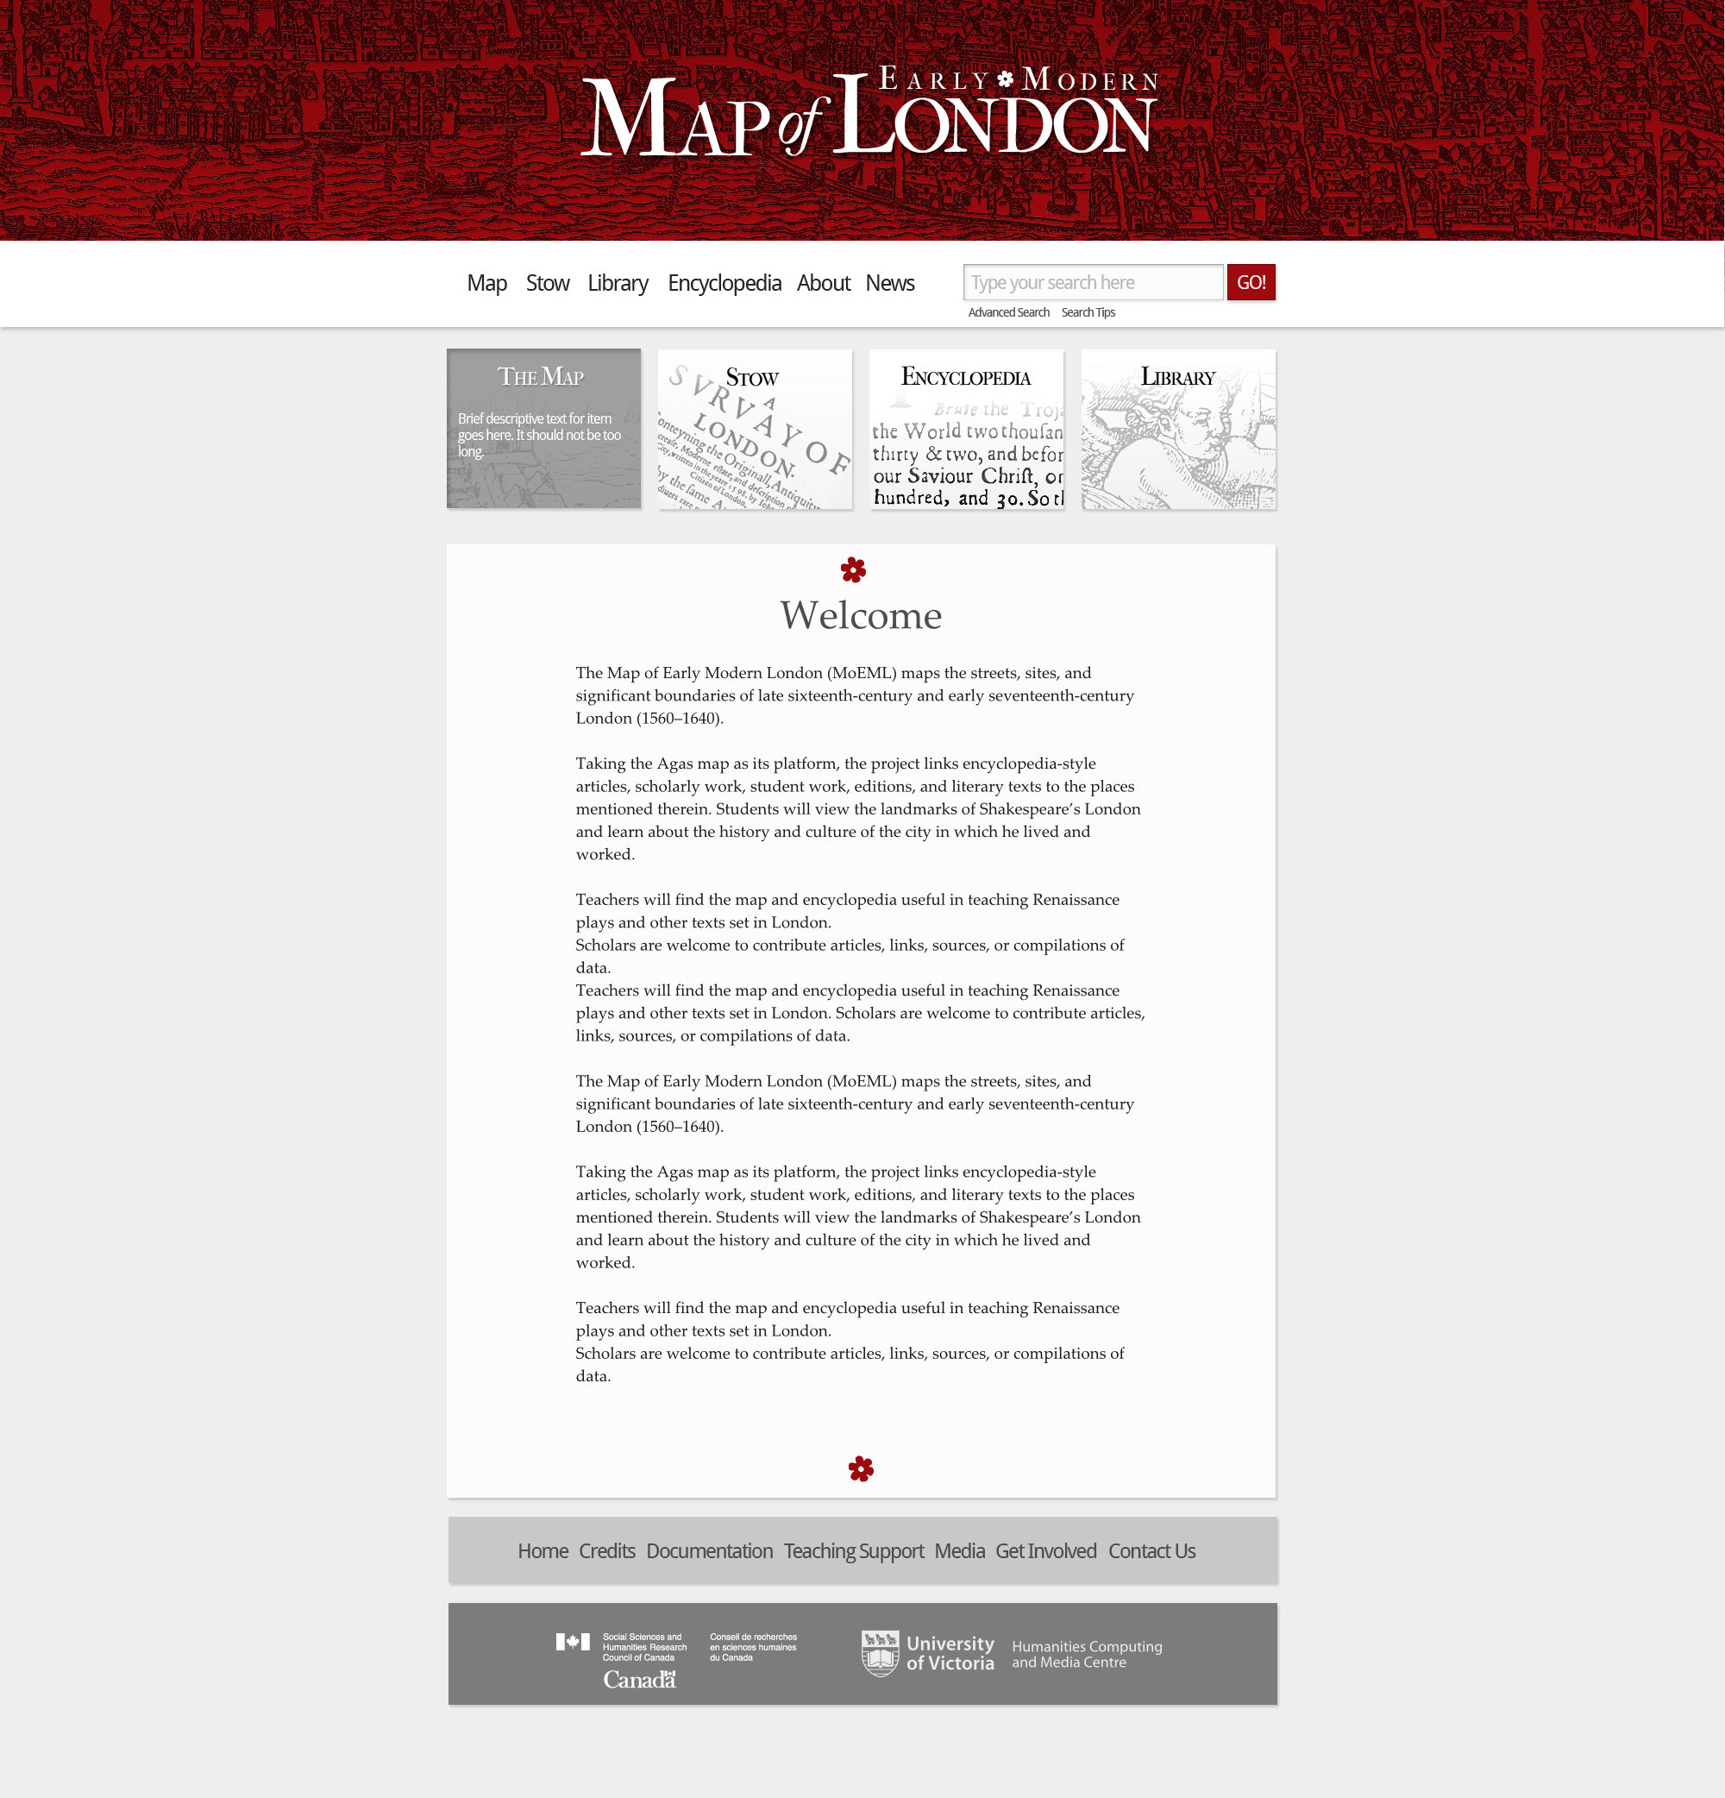


“And now completely finished”: Rebuilding and Expanding
The Map of Early Modern London
Janelle Jenstad
mapoflondon.uvic.ca

Slide 2
Main Project Goal
To build a spatial research and editorial environment for the study of early modern [Shakespeare’s] London.

Slide 3
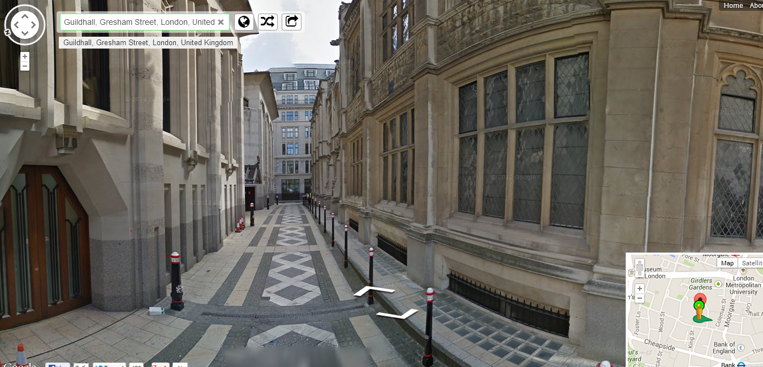

Slide 4
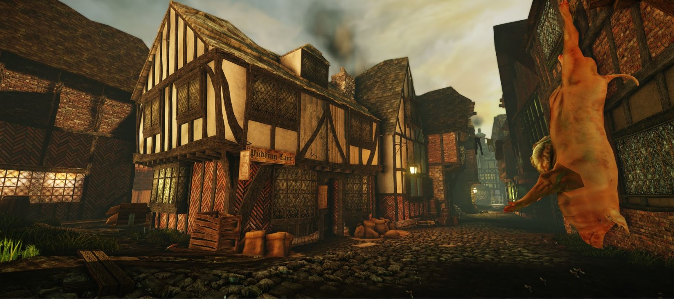
https://www.youtube.com/watch?v=SPY-hr-8-M0

Slide 5
Two Poles of Project
Agas Map
John Stow’s A Survey of London

Slide 6
Plan for Today
Project History: How MoEML has evolved with technology)
“Completely finished”? How MoEML is like the Survey of London
Tour of New Site

Slide 7
MoEML in Fits and Starts
1999 v.1
HTML / “image-mapped” digital object
2001 v.2 (1st rebuild)
HTML; frames
2006 v.3 (2nd rebuild)
XML and TEI; eXist database; layered map
2011 v.4 (3rd rebuild)
Streamlined XML; redesigned database; map now peripheral (a GUI)
Long hiatus: Move to UVic in 2003; joined TaPOR in 2005
2013 v.5
Visual and organizational redesign; all mayoral shows; code-sharing; document type taxonomy
2014 v.6
New map interface; A Survey of London

Slide 8
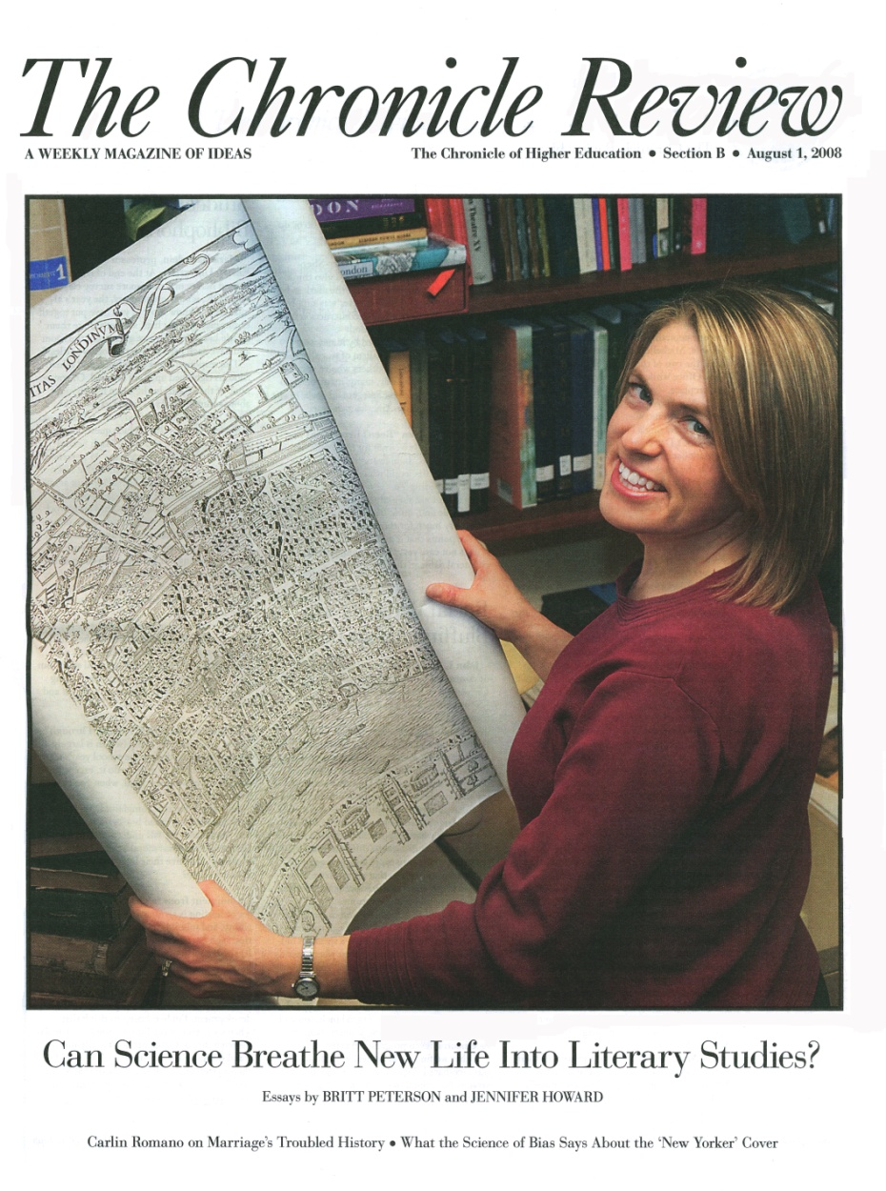
The Map Before MoEML
6’2” map of London
1560s
Bird’s-eye view
Woodcut (8 blocks)
Known as “Agas” map

Slide 9
Civitas Londinum. The “Agas” Map. Ca. 1561
Notes:
How did MoEML begin?
A map.

Slide 10
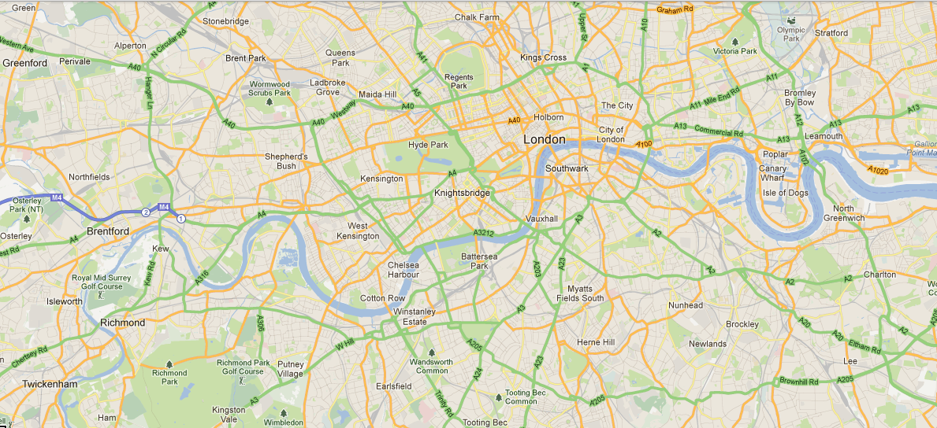
The square mile

Slide 11
MoEML v.1
“melted into air, into thin air” (The Tempest 4.1)
“Hard coded” in HMTL
A “mapped” image (done with LiveImage, a defunct image-mapping program)
Minimal research into site identifications

Slide 12
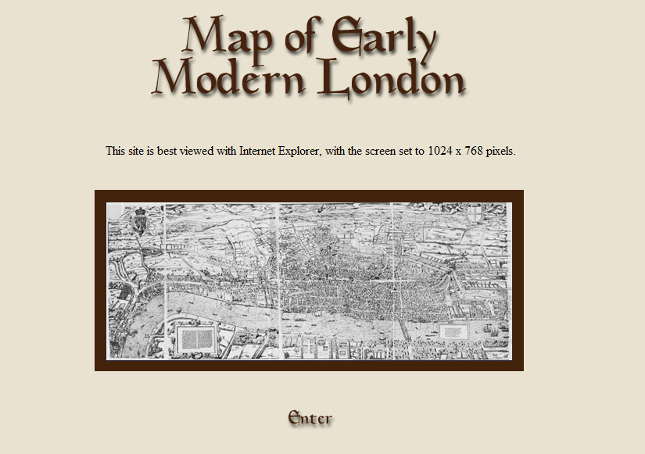
Top Page (v. 2, 2001)

Slide 13
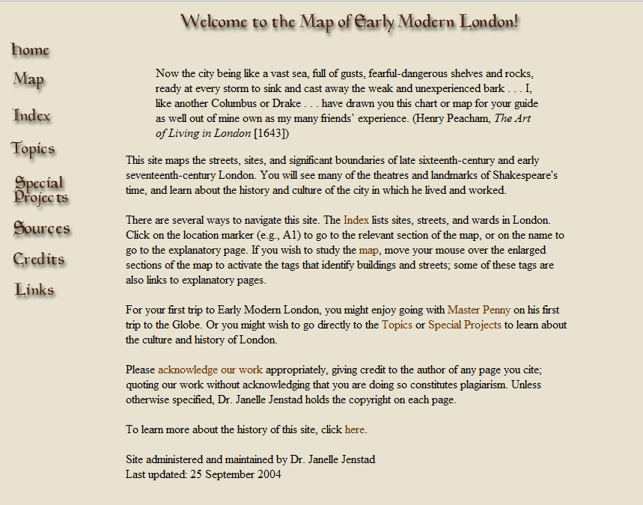
Home Page (2001)

Slide 14
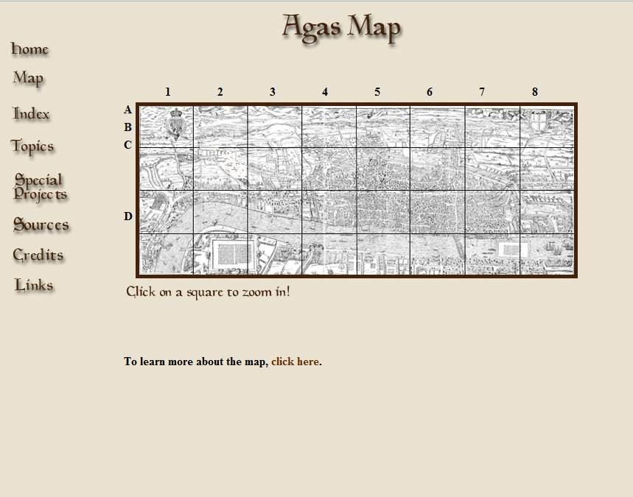
Map Page (2001)

Slide 15
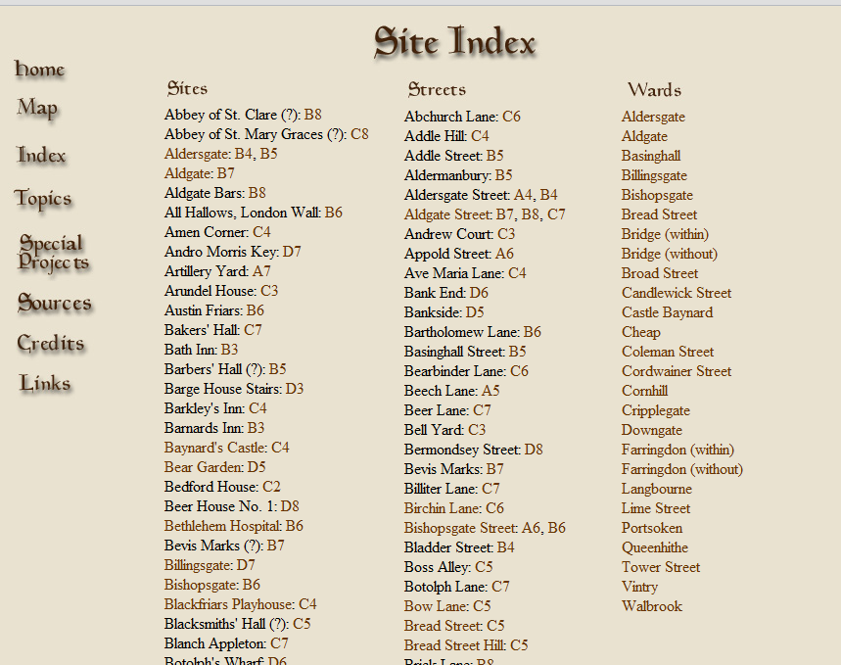
Site Index (2001)

Slide 16
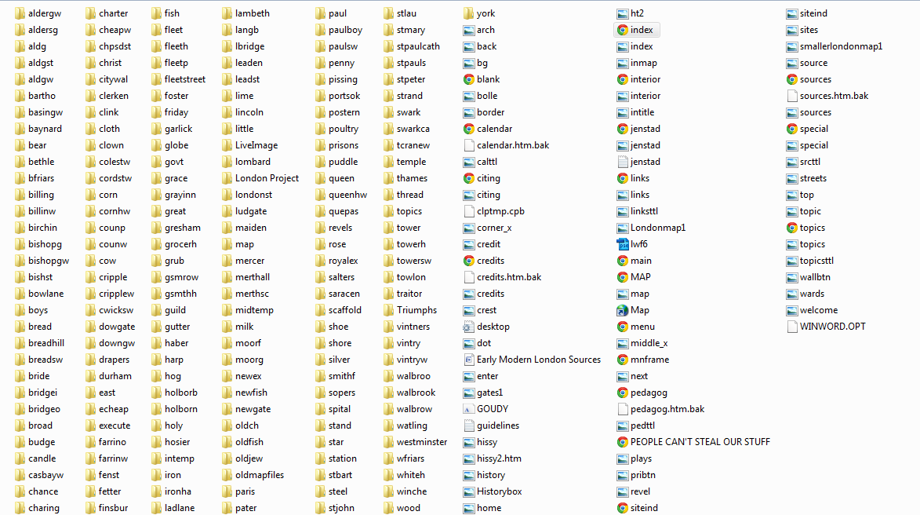
The “database” (2001)

Slide 17
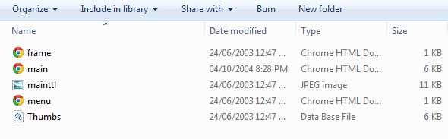
A street folder

Slide 18
MoEML v. 3
Joined TaPOR
Skills acquisition: TEI with Julia Flanders and Syd Bauman at DHSI
Re-encoded project: XML, TEI, CSS
Map scans from Guildhall Library
Layered-map technology (ViHistory)
+ Technical support, encoders, and consultants from UVic, HCMC, and TaPOR.
Went live August 2006.

Slide 19
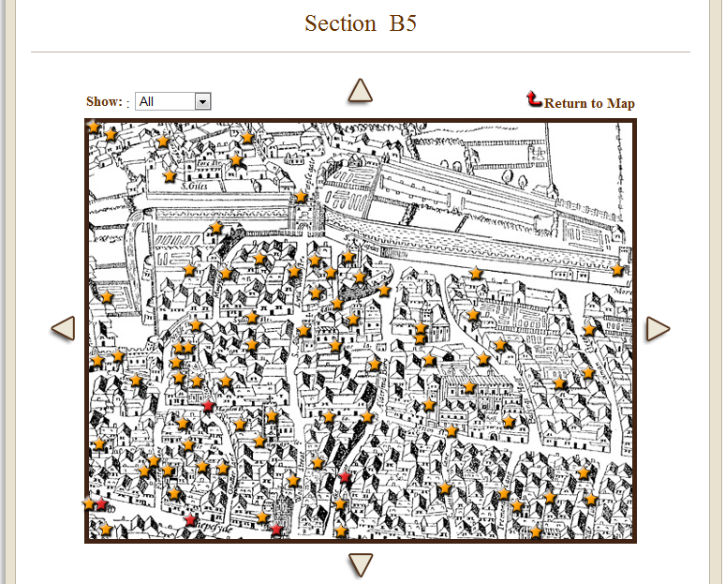
The “Star Map”

Slide 20
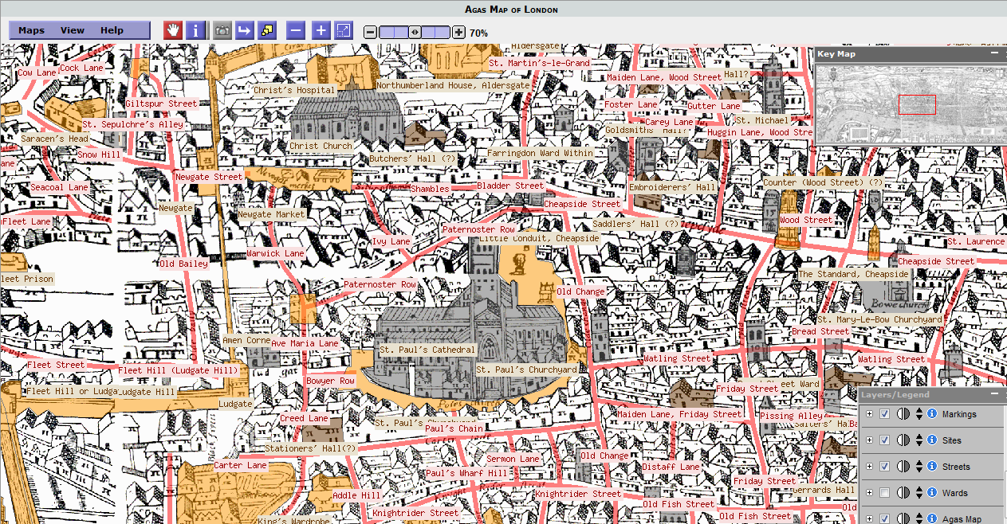
Experimental Map (2006-2012)

Slide 21
MoEML v. 4
Full TEI, XML, and CSS compliance
Showing our XML code
One file per place (all info in XML and TEI tags, incl. georeferences → GIS)
Map moved outside eXist database
Rebuilding map as a GUI to the data (in progress)

Slide 22
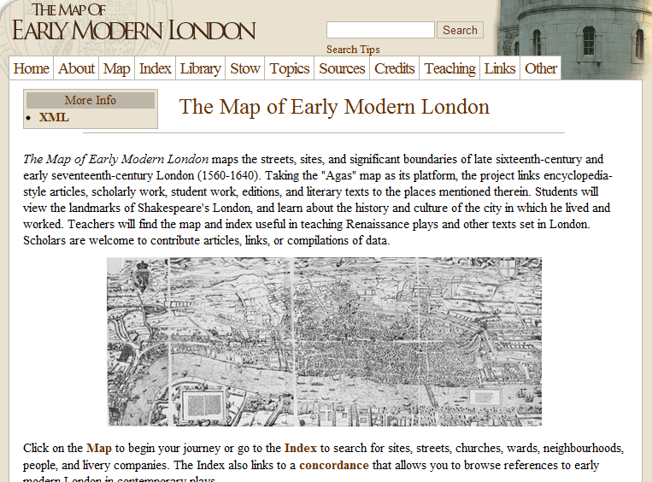
Home (2011-2013)

Slide 23
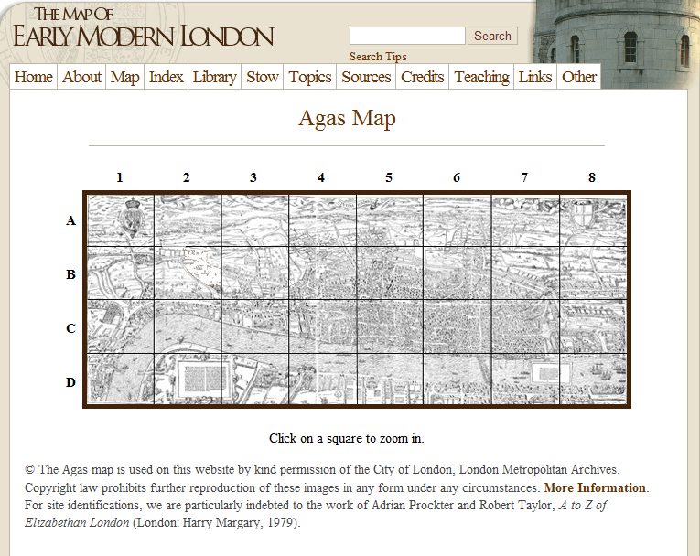
Map (2011-2013)

Slide 24
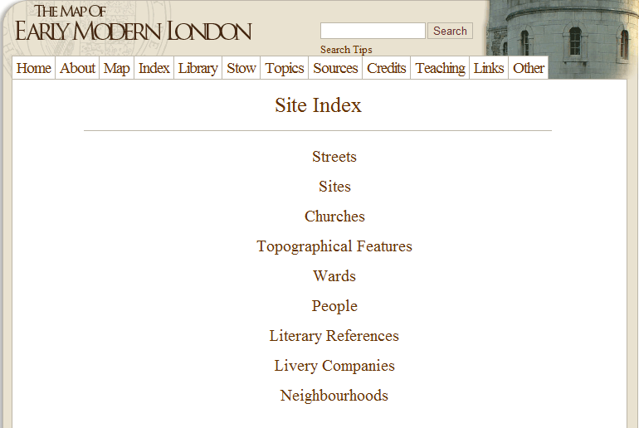
Index (2011)

Slide 25
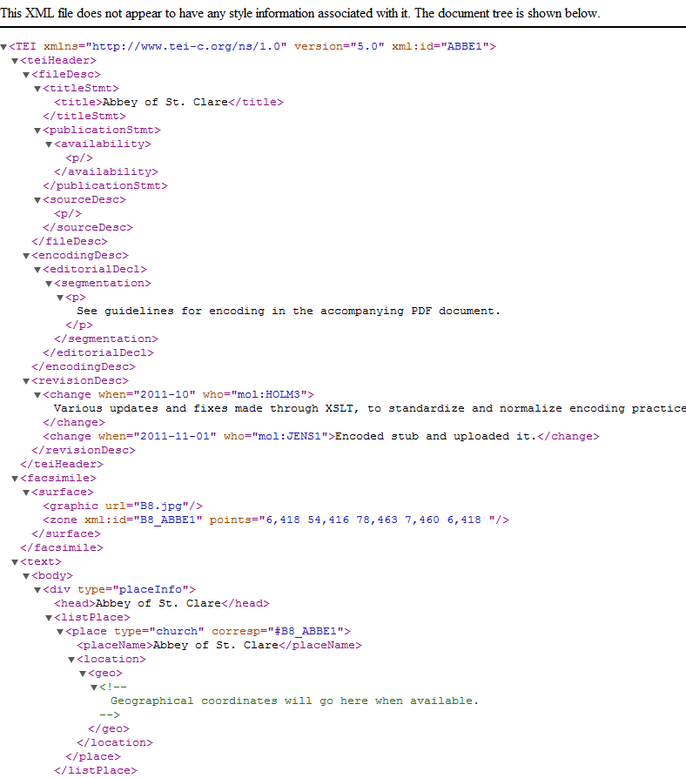
Total transparency about our encoding.
Mark Sample: “Own your ideas; make them free.”
(Martin Holmes on TEI Technical Council. Showing our craftsmanship.)

Slide 26
What was/is MoEML?
1999: A huge map with information attached.
2013: A huge database of texts and information with a map GUI (a GIS).

Slide 27
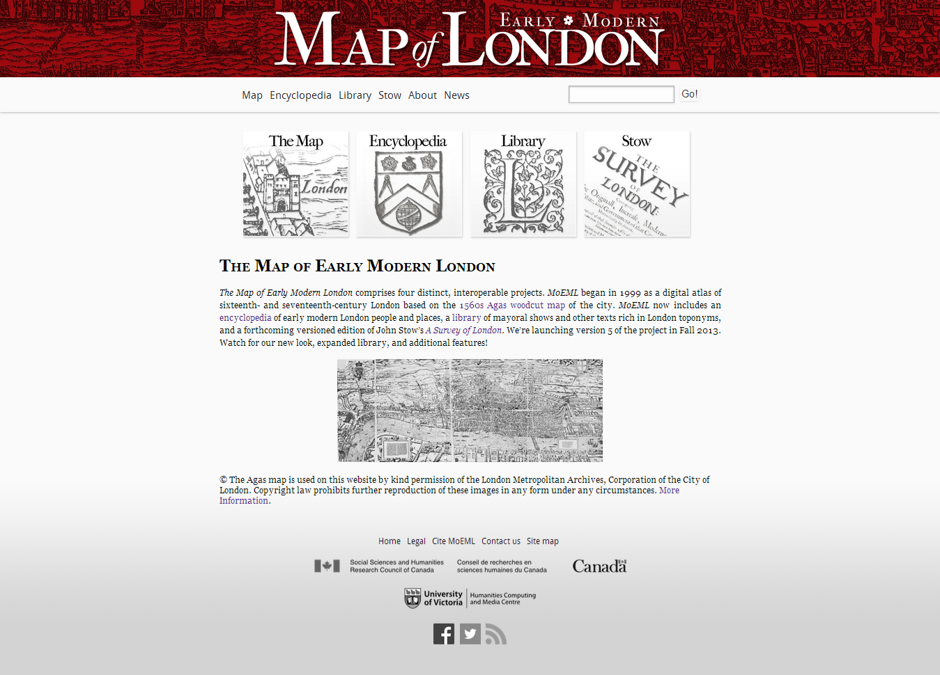
mapoflondon.uvic.ca

Slide 28
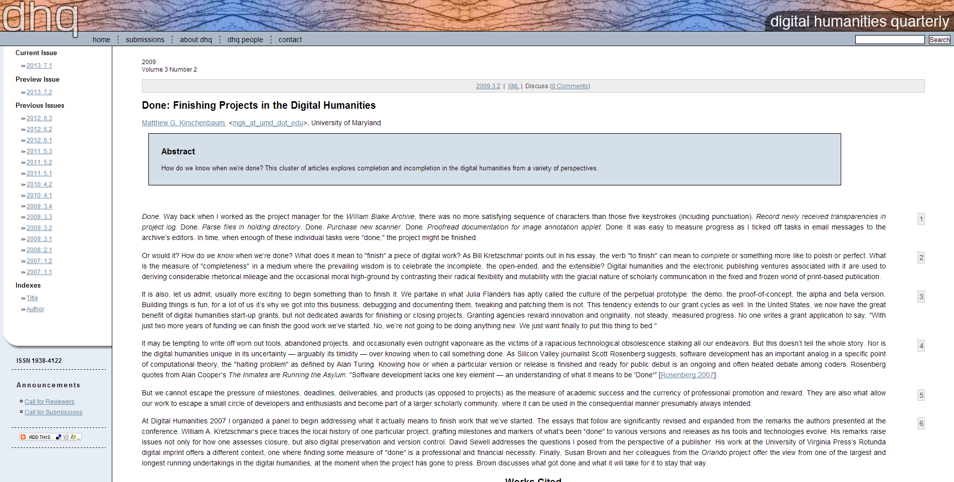
What does it mean to be “finished”?

Slide 29

John Stow
1524/5 – 1605
Bap. St. Michael Cornhill, London
Literary “editor,” antiquarian, and historian
Engraving by George Vertue (National Portrait Gallery)

Slide 30
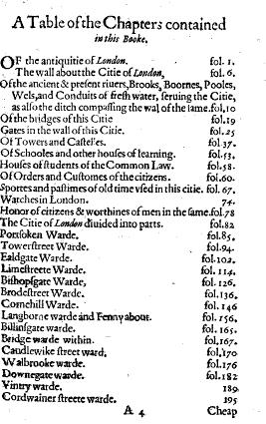
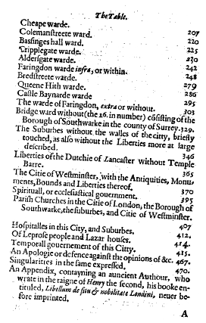
A Survey of London (1598)

Slide 31
Print History
1598
1598/1599: reissued with errata / new title page
1603: increased
[1605: Stow dies]
1618: continued, corrected, and enlarged
1633: completely finished

Slide 32
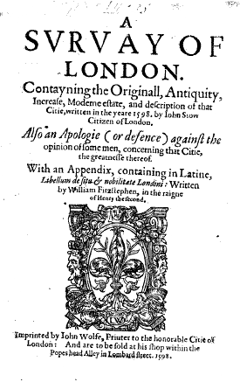
Title Pages
1598:
Also an Apologie (or defence) against the opinion of some men, concerning this Citie, the greatnesse thereof

Slide 33
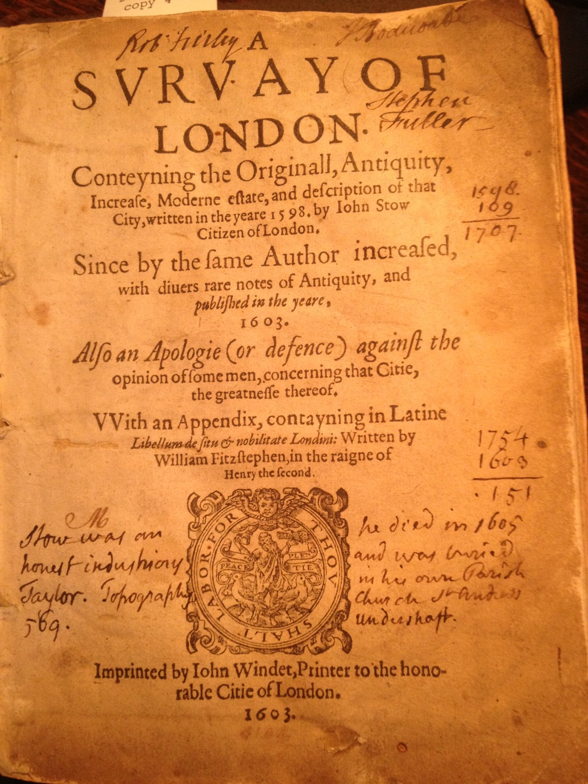
1603 Title Page
(Folger Shakespeare Library):
Since by the same Author increased

Slide 34
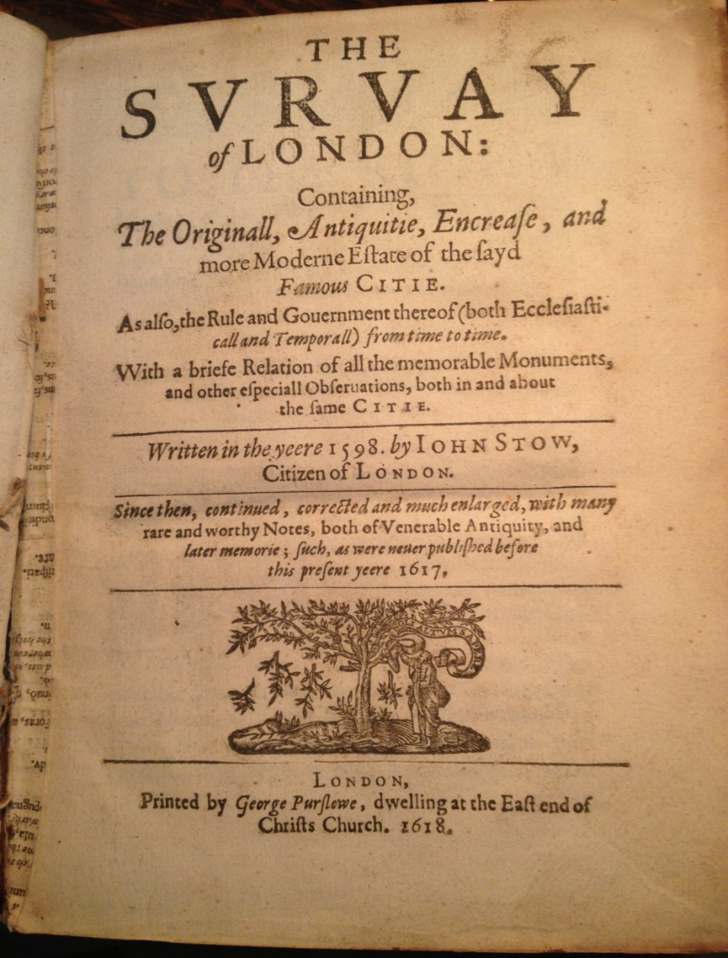
1618 Title Page (Folger Shakespeare Library):
Since then, continued, corrected and much enlarged

Slide 35
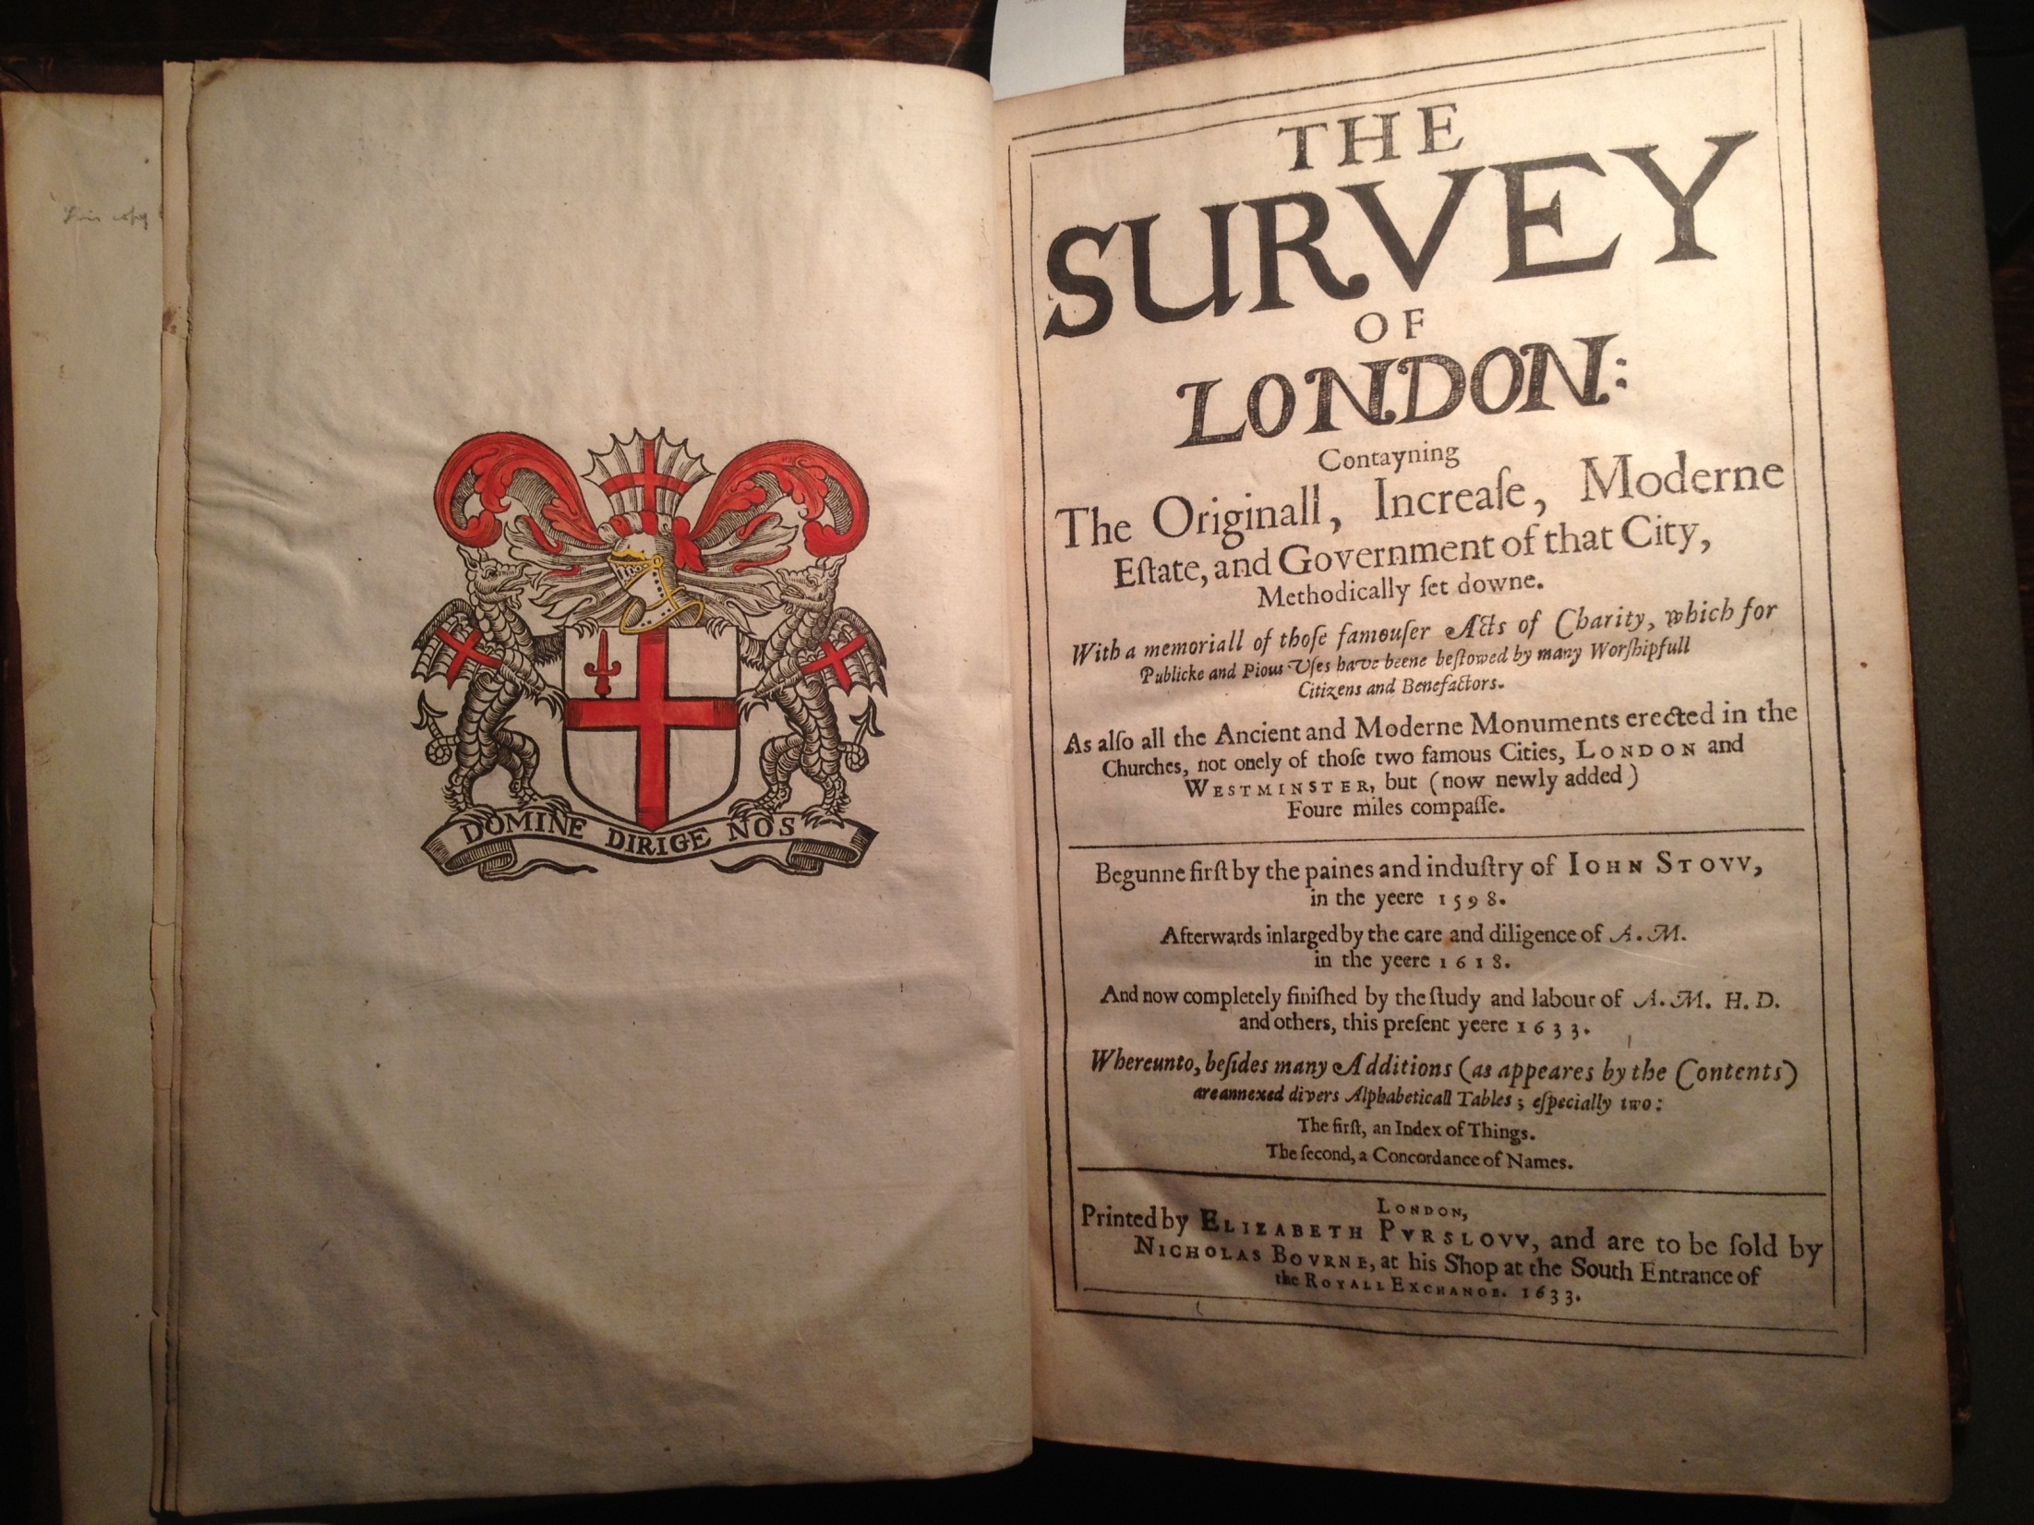
1633 frontispiece and title page
(Folger Shakespeare Library)

Slide 36
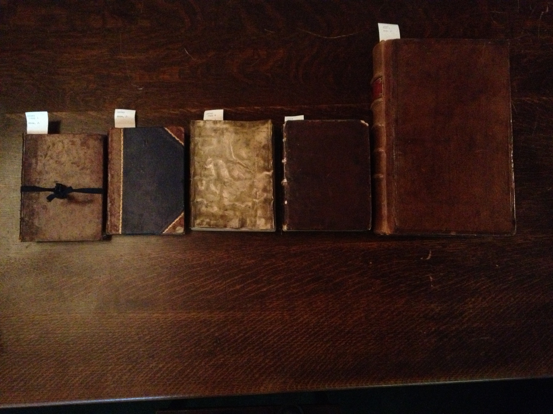
1598 quarto 1599 quarto 1603 quarto 1618 quarto 1633 folio
(Folger Shakespeare Library copies)

Slide 37
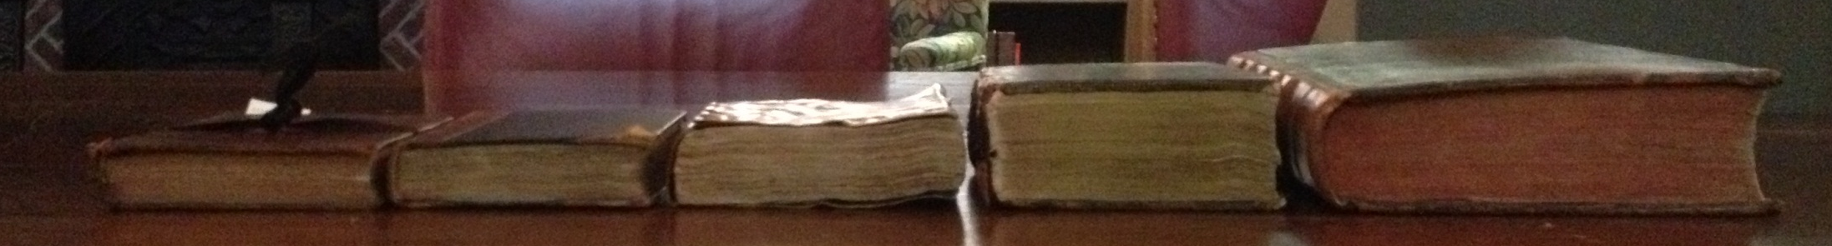
1598 quarto 1599 quarto 1603 quarto 1618 quarto 1633 folio
(Folger Shakespeare Library copies)

Slide 38
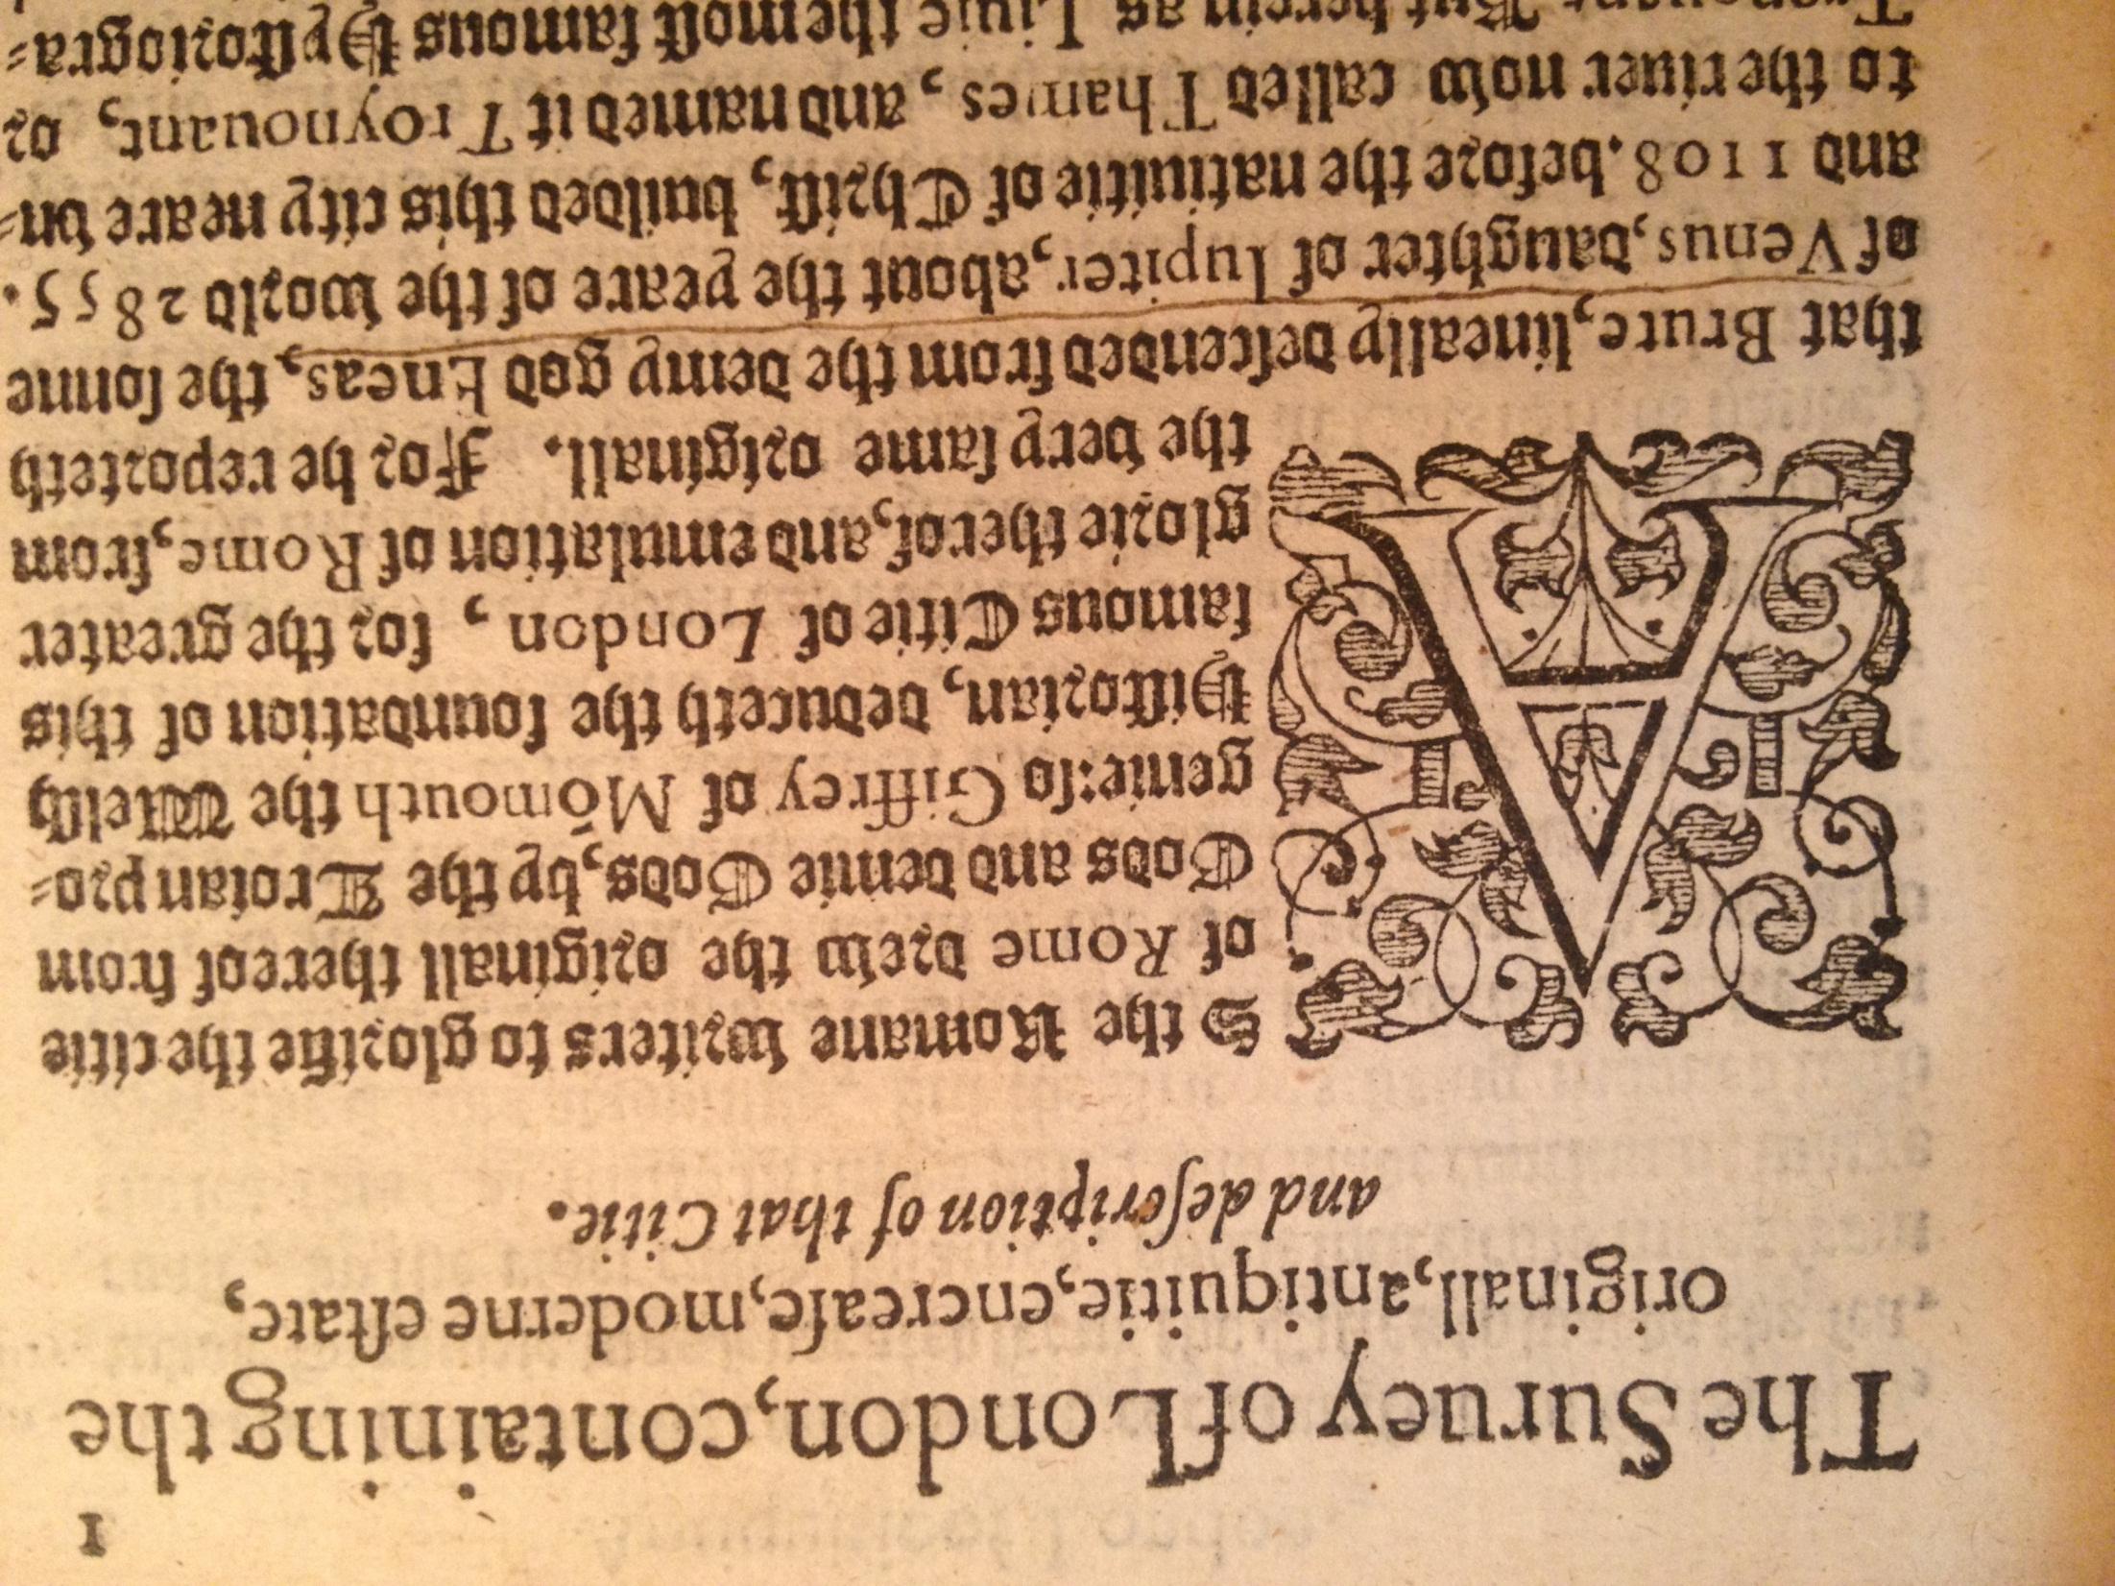
1603 Text in blackletter (Folger Shakespeare Library)

Slide 39
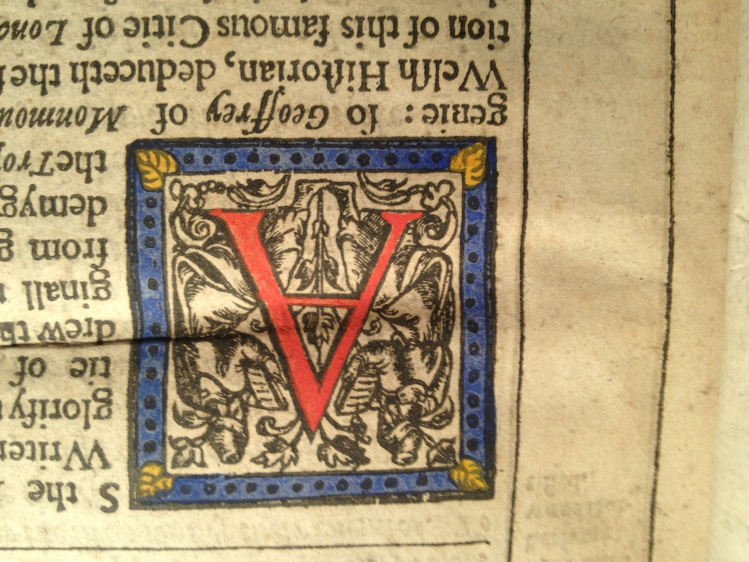

Slide 40
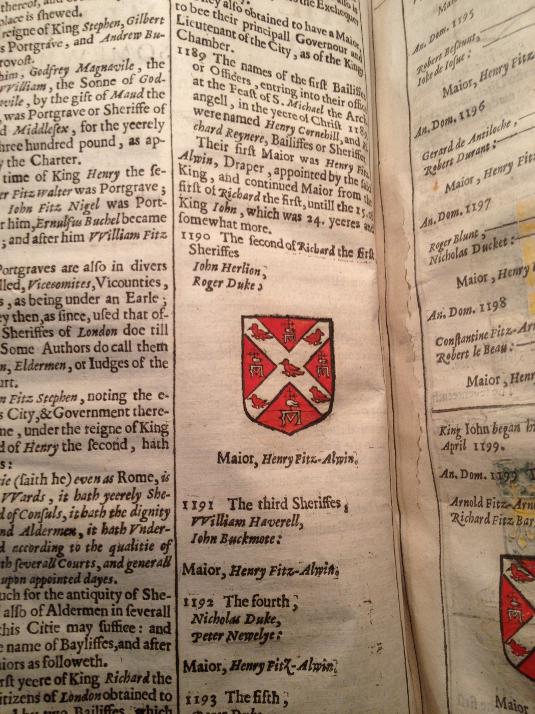

Slide 41
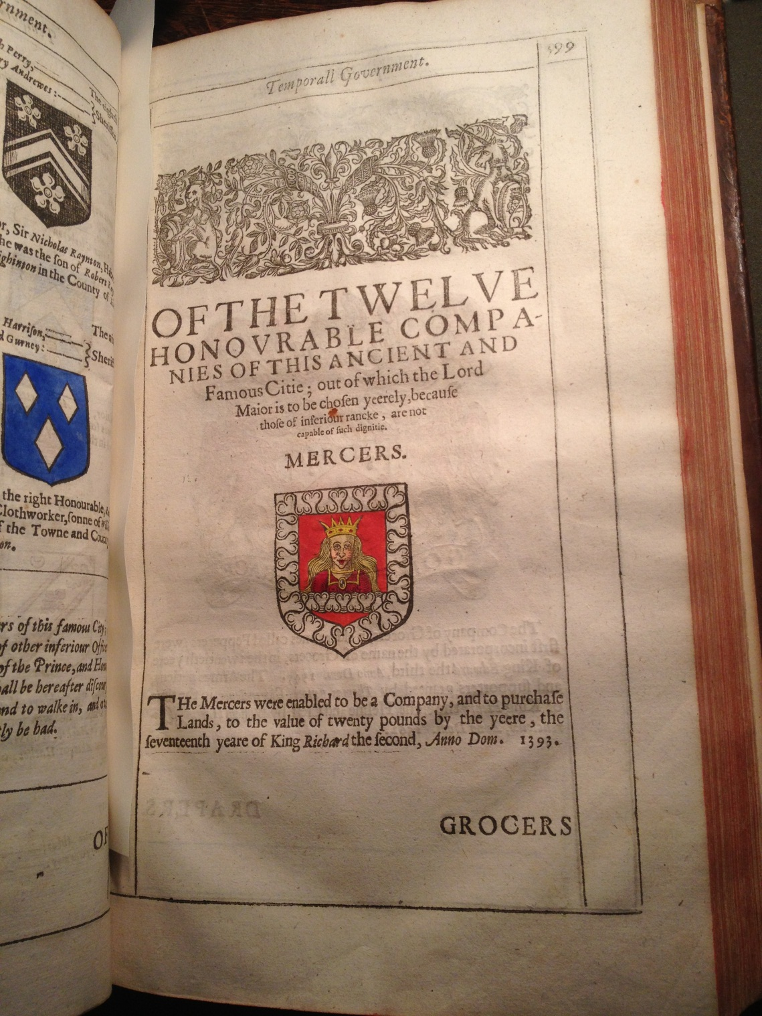

Slide 42
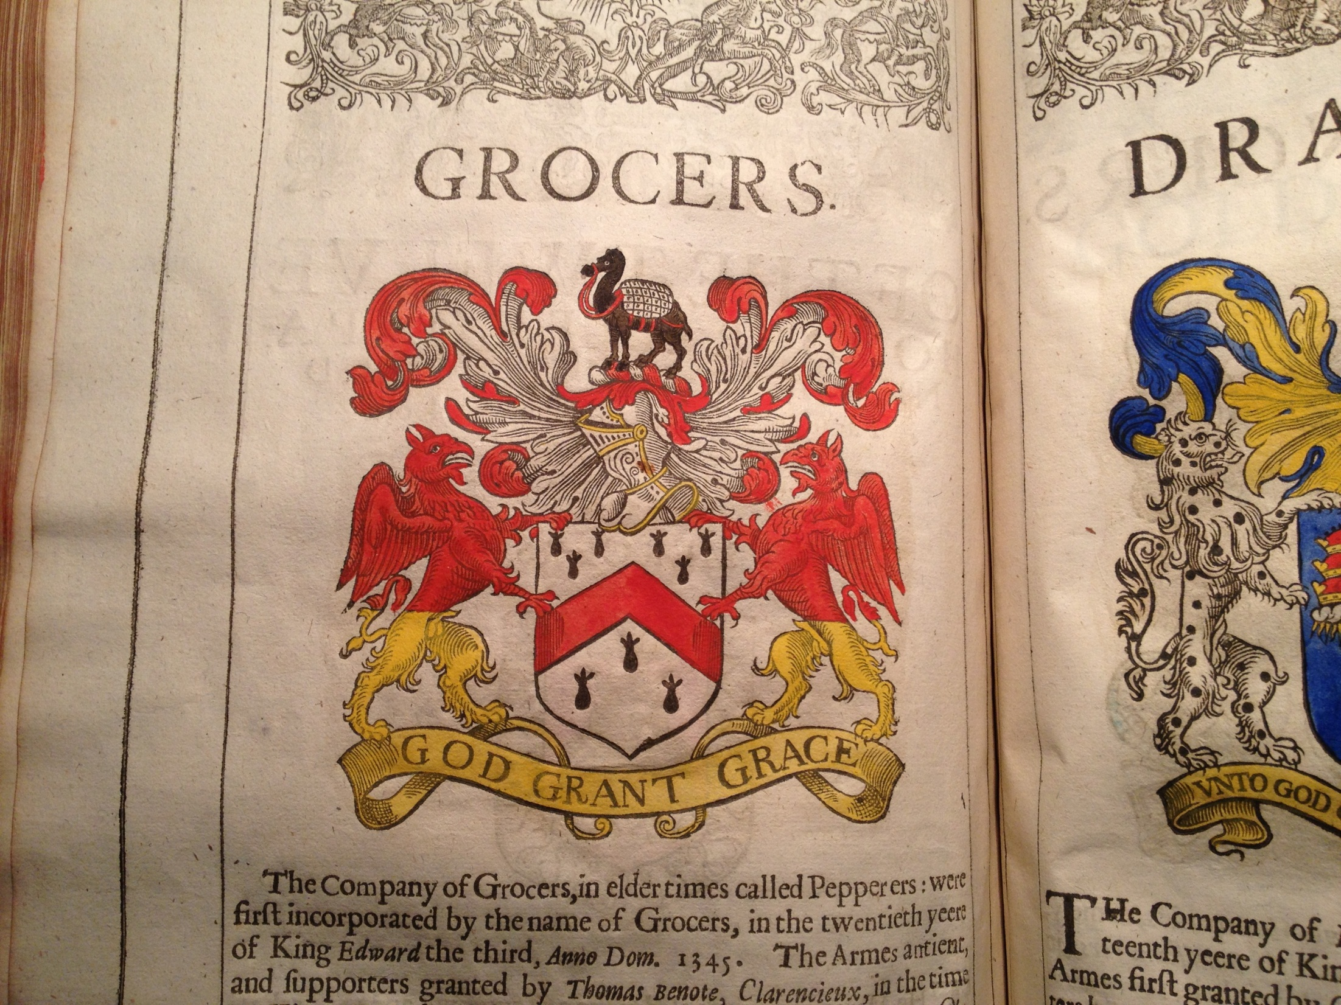

Slide 43
1633 frontispiece and title page
(Folger Shakespeare Library)
And now completely finished by the study and labour of A.M. H.D. and others.

Slide 44
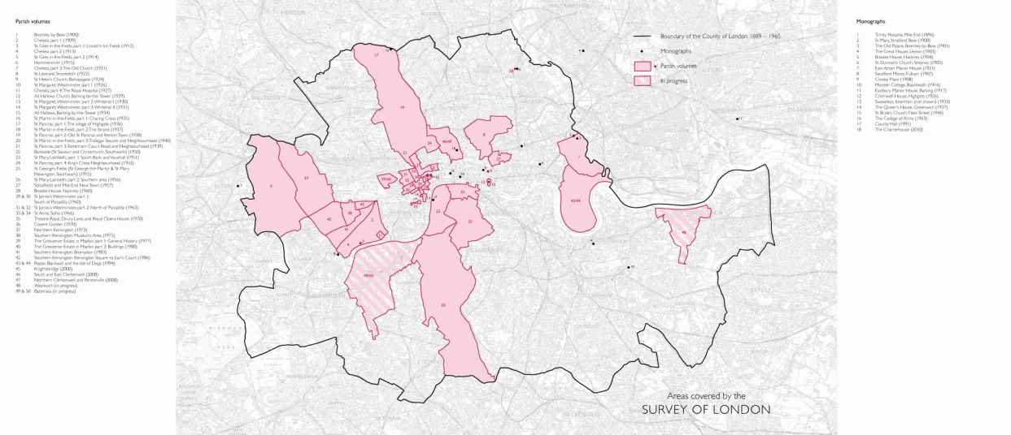
Adaptations / Continuations
1657: Londinopolis (Henry Howells)
1720: John Strype’s A Survey of the Cities of London and Westminster
1900-2008: English Heritage 47-volume Survey of London

Slide 45
Versioned Edition
1598
1603
1618
1633
+ page images of all four
Markup:
Names of people (all)
Dates (all)
Toponyms (all MoEML locations)

Slide 46
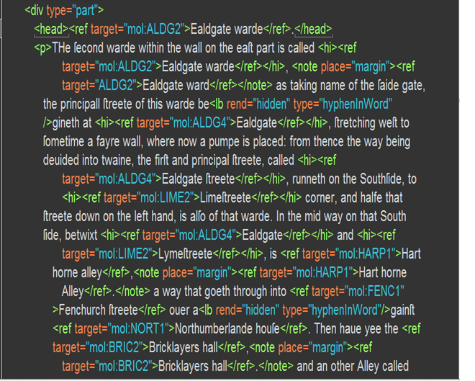
Notes:
Another shot of our TEI (first encoding pass).
Worked with EEBO-TCP.

Slide 47
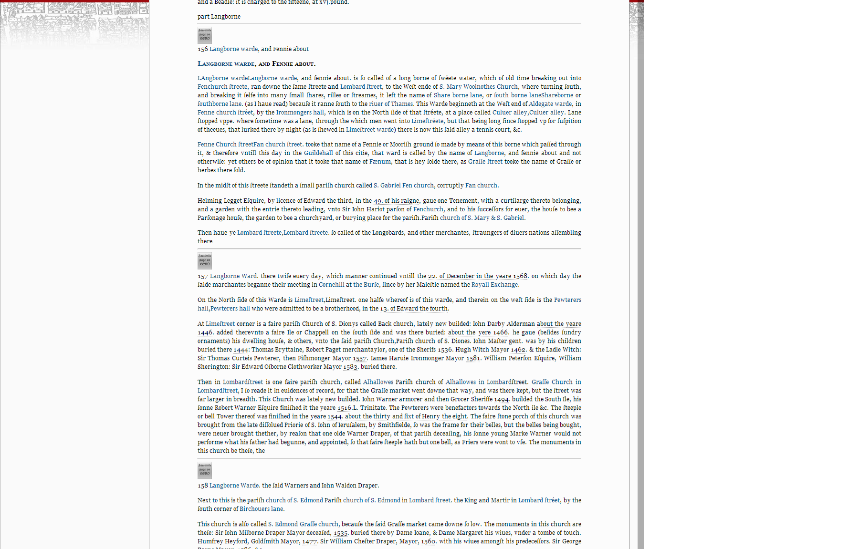

Slide 48
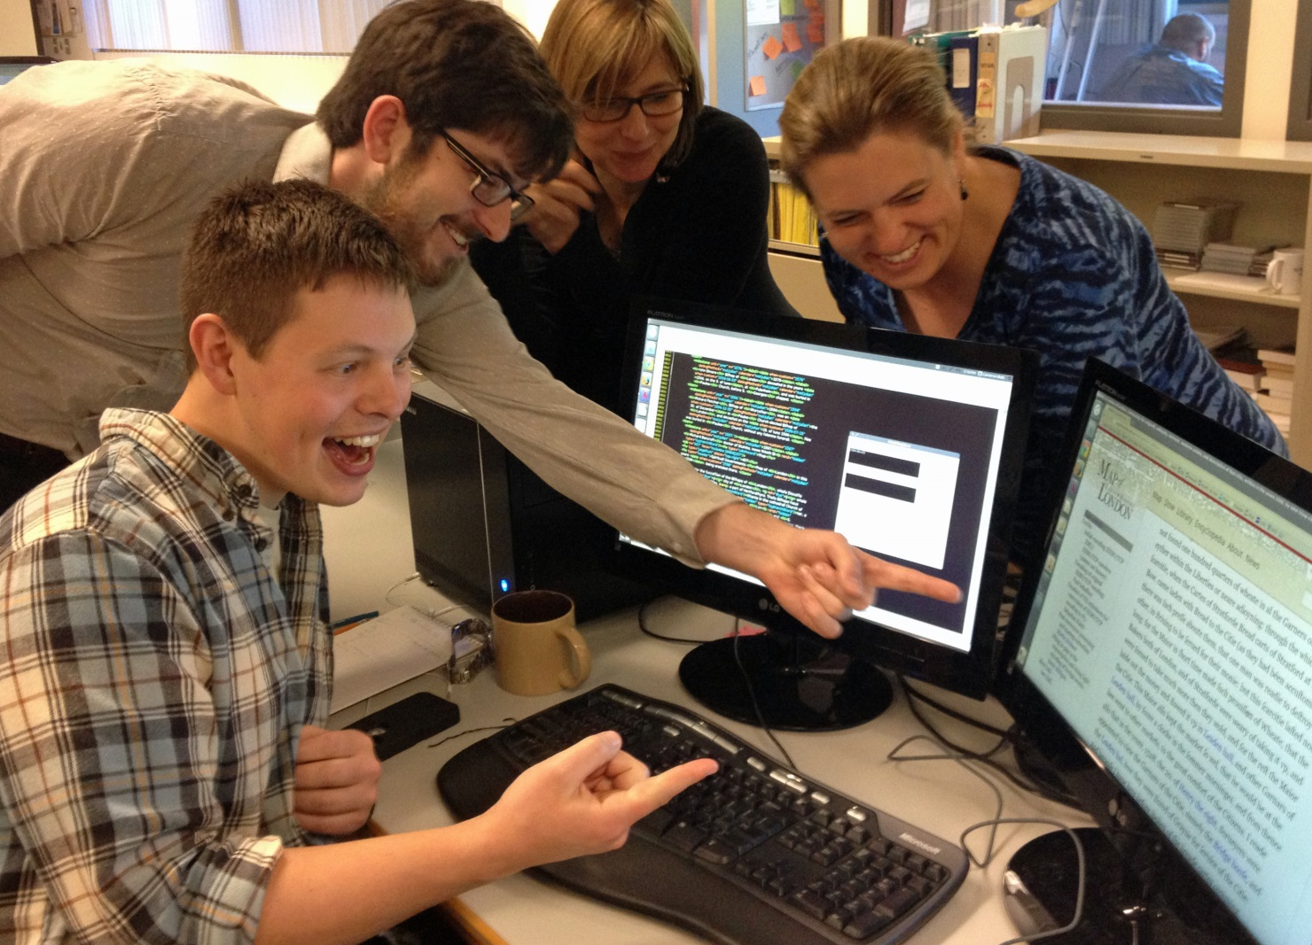

Slide 49
Jump into the project
mapoflondon.uvic.ca

Slide 50
The Future
Open Layers map platform.
We do the GIS.
Georeferenced archeological and historical data to help us pin down our locations in a database.
We use surface coordinates and our historical gazetteer
Datasets with addresses inbuilt (shops, residences, book colophons)
Our contributors do the literary geography

Slide 51
OpenLayers
1. LMA copy of “Agas” map (rescanned)
Ordinance survey map of London (reverse georectified)
Pewterplate engraving
GoogleMaps
Our “ideal” copy of the map
Pageant route
Your maps….
Notes:
A base layer that reproduces the LMA copy of the “Agas” map. To produce this base layer, we will have had to exercise our critical judgement in joining the eight sheets. Since they do not join perfectly, our work will be to leave the appropriate amount of space between the sheets. This layer satisfies our desire for a documentary edition.
A layer that includes our conjectural drawings of the places that occupied those white spaces, based on other cartographic witnesses to the text of London, such as the three surviving sections of the Copperplate Map (likely the source for “Agas”). This layer allows us to offer an edition that “reconstructs” an ideal text and supplies the missing visual data.
Layers that reproduce the other witnesses, either in their entirety (depending on permissions) or merely the pieces that are different in the LMA copy. This layer serves as the horizontal collation of witnesses (horizontal in the bibliographical sense even though the layers themselves are stacked “vertically”). Combining the LMA layer with the National Archives layer allows us to produce an edition that conflates the evidence from the principal documentary witnesses.
A layer containing our own mark-up of the map, which is essentially a form of glossing and critical commentary. Users can turn on and off levels of commentary (site ids only, ids of particular types of sites only, alternate names for a site, particular parts of the encyclopedia entry for the site).
A modern ordnance survey map of the City of London, instead of the GoogleMaps or GoogleEarth layer that one often sees in historical mapping projects. We want more precision than GoogleMaps can offer. This layer allows us to answer a common question: “What’s there now?” In thinking about the relationship between early modern London and modern London, I am turning increasing to theories of adaptation. In a way, both the modern ordnance survey map and the “Agas” map are adaptations of real physical space. We could see this layer either as cognate with “Agas” as another representation of a set of spatial coordinates. If we want to “pin” this layer to the “Agas” map, we will have to either georectify “Agas” or reverse georectify the ordnance survey map so that the latitude and longitude points match up.
A dynamic map layer that can be annotated by the user, or populated with data from our personography, library, or bibliography in combinations that the user determines. This layer satisfies our desire for an edition that can be marginated and annotated by “readers.”
See the Crace Collection of Maps of London, for example, at http://www.bl.uk/onlinegallery/onlineex/crace/index.html. This stunning resources allows one to load up historical maps of London in GoogleEarth, something that we have also done with the “Agas” map for in-house use.

Slide 52
Thank you!
Acknowledgements:
Martin Holmes, Programmer, HCMC, University of Victoria
Kim McLean-Fiander, Assistant Project Director and Post-Doctoral Fellow
The MoEML Research Team
Social Sciences and Research Council of Canada
Contact us:
london@uvic.ca
jenstad@uvic.ca
mapoflondon.uvic.ca

